Slide 1
Band-Aids on a Gunshot Wound
When God Speaks (Judges 10:1-16)
Dr. Andrew Spurgeon, Crossroads International Church Singapore
BibleStudyDownloads.org

Slide 2
Band-Aids on a Gunshot Wound
Lessons from Judges

Slide 3
The Book of Judges
Theme: “In those days there was no king in Israel; each person did what was right in his/her own eyes” (21:25).
God was their king (8:23), but they didn’t live under His rule.

Slide 4
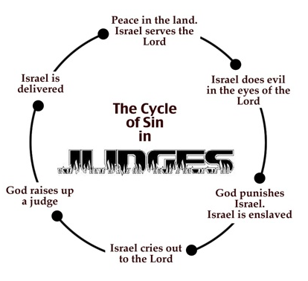

Slide 5
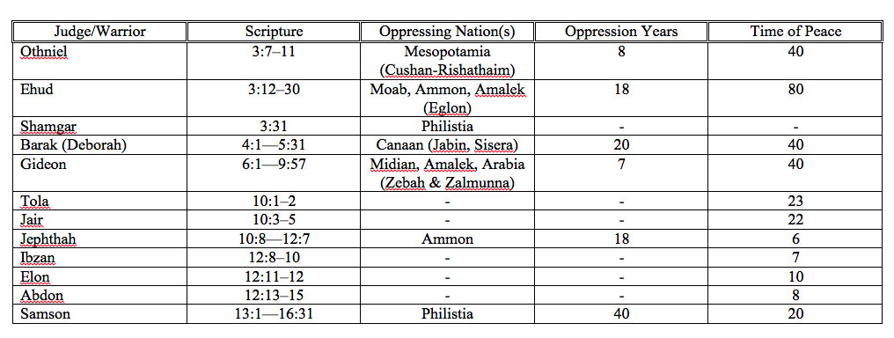

Slide 6
God Speaks He Is Justified When He Speaks!
Judges 10:1–16

Slide 7
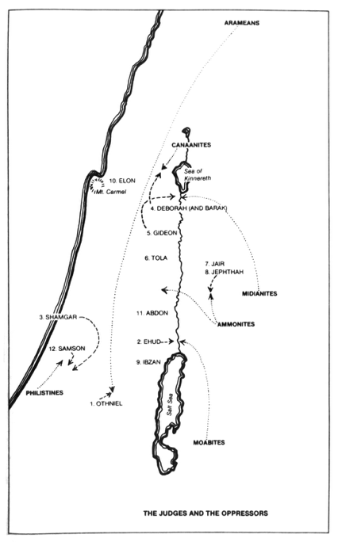

Slide 8
The First Elements of the Cycle (Judges 10:6–10)
Again the Israelites did evil in the eyes of the LORD. They served the Baals and the Ashtoreths, and the gods of Aram, the gods of Sidon, the gods of Moab, the gods of the Ammonites and the gods of the Philistines. And because the Israelites forsook the LORD and no longer served him, he became angry with them. He sold them into the hands of the Philistines and the Ammonites, who that year shattered and crushed them. For eighteen years they oppressed all the Israelites on the east side of the Jordan in Gilead, the land of the Amorites. The Ammonites also crossed the Jordan to fight against Judah, Benjamin and the house of Ephraim; and Israel was in great distress. Then the Israelites cried out to the LORD, “We have sinned against you, forsaking our God and serving the Baals.”

Slide 9
God Spoke and Refused to Help (Judges 10:11–16)
The LORD replied, “When the Egyptians, the Amorites, the Ammonites, the Philistines, the Sidonians, the Amalekites and the Maonites oppressed you and you cried to me for help, did I not save you from their hands? But you have forsaken me and served other gods, so I will no longer save you. Go and cry out to the gods you have chosen. Let them save you when you are in trouble!” But the Israelites said to the LORD, “We have sinned. Do with us whatever you think best, but please rescue us now.” Then they got rid of the foreign gods among them and served the LORD. And he could bear Israel’s misery no longer.

Slide 10
Narrative Pause
“When the Egyptians, the Amorites, the Ammonites, the Philistines, the Sidonians, the Amalekites and the Maonites oppressed you and you cried to me for help, did I not save you from their hands?”

Slide 11
Application
Biblical “meditation” is not a gaze into oblivion; it is a recollection of God’s faithfulness in our lives, over the past many years. We are to pause, recollect, and tell others of God’s faithfulness in our lives.
Exodus 10:1–2, “The LORD said to Moses, ‘Go to Pharaoh, for I have hardened his heart and the hearts of his officials so that I may perform these miraculous signs of mine among them that you may tell your children and grandchildren how I dealt harshly with the Egyptians and how I performed my signs among them, and that you may know that I am the LORD’”

Slide 12
Black

Slide 13
OT Sermons link at biblestudydownloads.org
Get this presentation and script for free!

